Slide 1

Working with Application Frameworks and ArcGIS API for JavaScript
Matt Driscoll (@driskull)
Derek Swingley (@derekswingley)
http://tinyurl.com/arcgismvcjs
Notes:
Overall flow could be…
Matt: slides 2 and 3
Derek: slides 4 and 5
Matt: slide 6
Derek: slide 7
Matt: slide 8
Slides 9 and 10…doesn’t matter

Slide 2




JavaScript-based Application Frameworks
MVC
Notes:
Matt:
Briefly intro MVC: models are your data, views are representations of models and controllers handle your logic as well as communication between models and views.
MVC is about separating out your app by functionality and purpose. Controllers manipulate models, models manipulate views and views render data.
Each framework does things in their own way, but the underlying concepts are the same.
The clipboard icon is a link to http://todomvc.com/ which has examples for every major JS-based MVC framework in use today. It’s worth telling session attendees about this resource so they can explore it later.

Slide 3
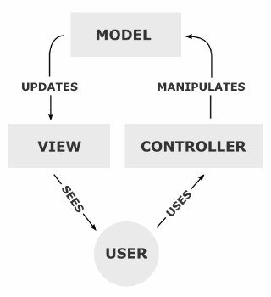
Why?
Separation of concerns
DRY
Easy to test
Fun (do more with less code)
Notes:
Matt:
Separation of concerns: your JS shouldn’t be directly updating your DOM. Modularize your data, application logic and your presentation of information.
DRY: don’t repeat yourself: do things in one place, easier to maintain your code, less error prone. Let framework handle events and routing.
Testing: we are not talking about testing here, but one of the primary reasons to use these frameworks is so that you can easily unit test your apps.
Fun: write less boilerplate/scaffolding, focus on doing tasks unique to your app.
Not having to Creating/disconnecting events
Minimizes dependencies
Easier to find what you’re looking for with large applications.
Can have multiple people working on different things like models and views and they wont be editing the same file in some cases.

Slide 4
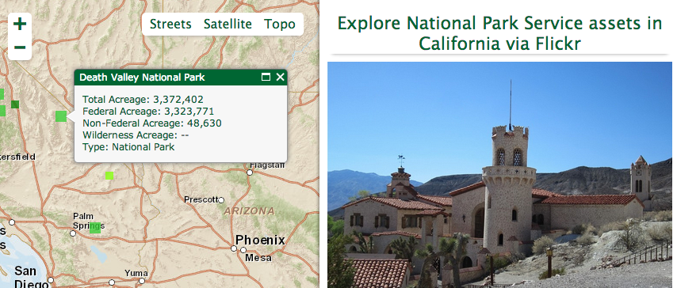
First, we need an app…
Notes:
Originally built a couple of years ago with a previous release of the ArcGIS API for JavaScript. All JS API + Dojo. No MVC… manually manipulating DOM, concatenating strings…got the job done, and many, many apps are built this way, but there are tons of places for improvement.

Slide 5
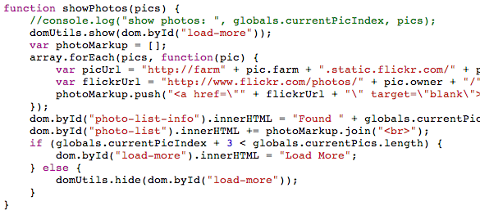
Notes:
Example of what we’re going to try to avoid… hard-coded references to DOM elements, manually building HTML and injecting it.
Side note: the function shown here isn’t actaully a global as it lives inside the require() callback…so it’s not all bad ☺.

Slide 6
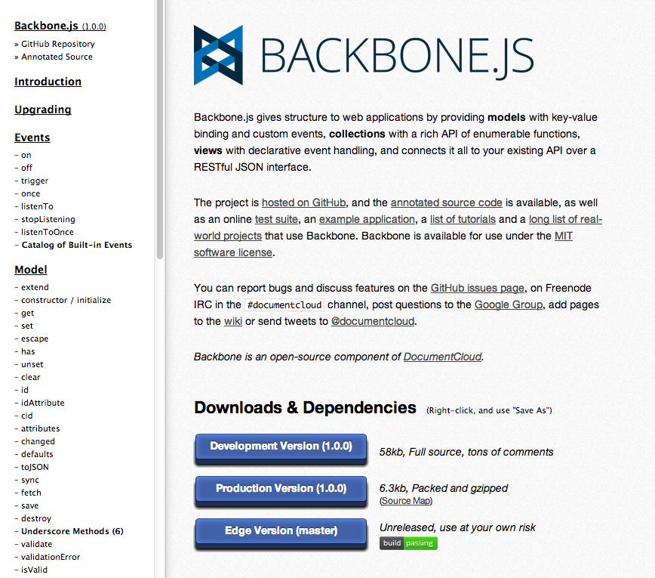
Backbone.js
Notes:
First up is backbone.js
This is what their site looks like

Slide 7
Features
Models
Views
Events
Collections
Routes
History
Notes:
Models
-Handle functionality of your app and changes that happen.
Views
- Views are backed by models and can update HTML and dom nodes when the model changes
- Can be used with any templating library, for this app I used Underscore templates.
Events
- Similar to dojo events. Has .on() and .off() to bind events to an object.
Collections
- Allows you to bind events on a collection of models
- Listen to multiple models
- Song is model, album is Collection.
Routes
- Has a router than handles URL in page links like hash tag anchor links and redirects them to a function.
- Great for single page apps that want to link to a specific function
History
- Once all your routes are created, a history can be started to be able to use the back button within your single page app

Slide 8
Pros
Wide adoption
Clear MVC implementation
Routers / History
Underscore Helper Functions
Cons
Dependencies
$
_
Notes:
First up: Backbone. Probably the jQuery of JS MVC frameworks.

Slide 9
Angular.js

Slide 10
Pros
Docs/Tutorials
Built-in AJAX / JSONP
Magic
Google
Cons
Fuzzy MVC implementaiton
Non-standard markup (ng-*)
Magic
Google
Notes:
Next: Angular.

Slide 11
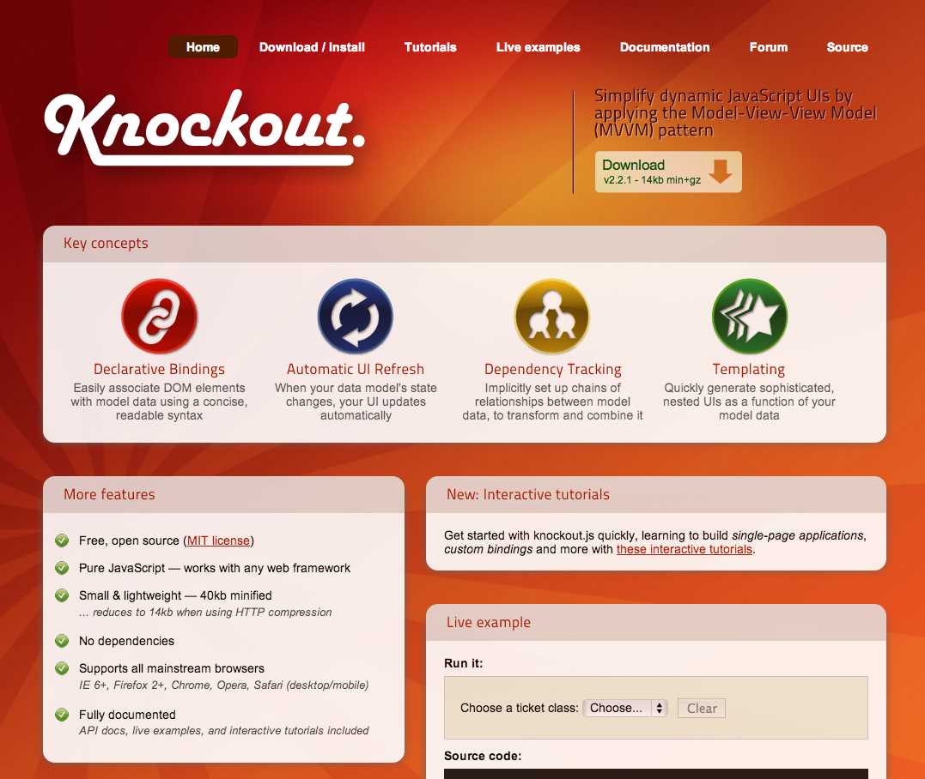
Knockout.js
Notes:
Knockout

Slide 12
Features
View-Models (MVVM Pattern)
Observables
Bindings
Templates
Notes:
Knockout has a combo of views and models in a single object. Model view view model pattern.
It has “observables” which you set what properties on your object or model you’d like the framework to keep track of and when it changes it updates the view or does other functions as you can assign.
It has bindings, where you set in HTML using a HTML5 data attribute named data-bind=“your binding”.
It basically sets up your events for that dom element and makes it really easy to set up and modify events for your app.
And it has template rendering so that you’re not just concatenating strings to write HTML within JS.

Slide 13
Pros
No dependencies
Uses AMD if define found
Good docs & examples
Cons
No routes/history
HTML can become bloated with bindings
Notes:
Make sure Dojo or require.js is loaded before Knockout so that define is defined

Slide 14
?

Slide 15
Matt Driscoll (@driskull)
Derek Swingley (@derekswingley)
http://tinyurl.com/arcgismvcjs
http://esriurl.com/survey
Thursday, March 28th – Offering ID: 394

